Slide 1
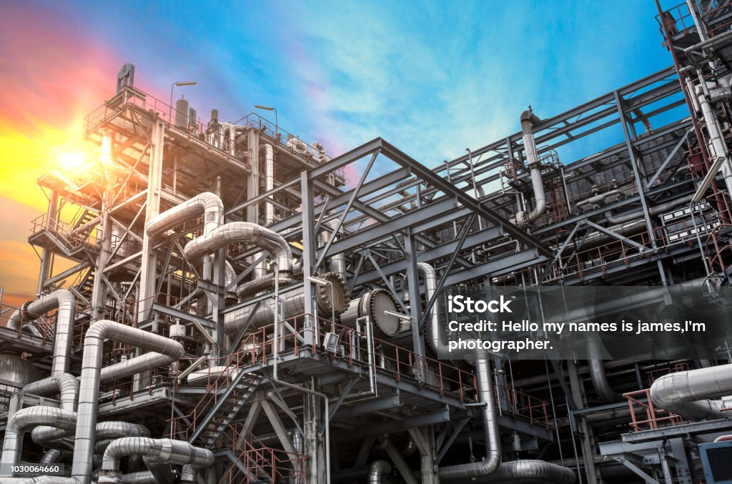
Albrecht Indutherm
About us
Services
Products
References
Contact
About Albrecht Indutherm
Your partner for the planning and design for industrial boiler system
Albrecht Indutherm is a global company with a focus on the planning and design of industrial boiler systems for the chemical, non-ferrous and environmental industry.
Our high qualified engineers have many years of in-depth knowledge of boiler design and stand for customer-oriented planning of highly efficient, reliable and economical boiler systems.
Our technologies are tailored to the customer's technical requirements. The boiler systems are designed with the most modern software systems and comply with the officially required and valid regulations and technical standards.
As an innovative expert for heat recovery in industrial plants, we make an important contribution to energy saving and environmental protection.
Headquarter: Germany, Dortmund

Slide 2

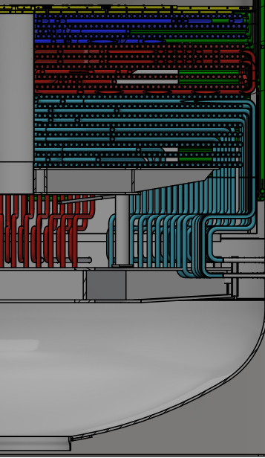
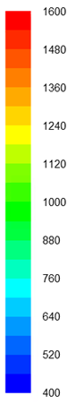
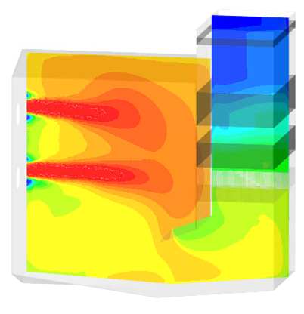
Albrecht Indutherm
About us
Services
Products
References
Contact
Services
Design for Tailor made Boiler System
Project Development
Concept engineering & feasibility studies
Consulting
Tenders and inquiry documentation
Basic + Detail Boiler Engineering
Calculations and process design
Thermal calculations
Water /steam re-circulation calculations
CFD studies
Basic- Layout drawings
Flow- and P&I diagrams
Strength calculation for pressure parts
Plant design, Piping - with partner
Steel structure - with partner

Slide 3
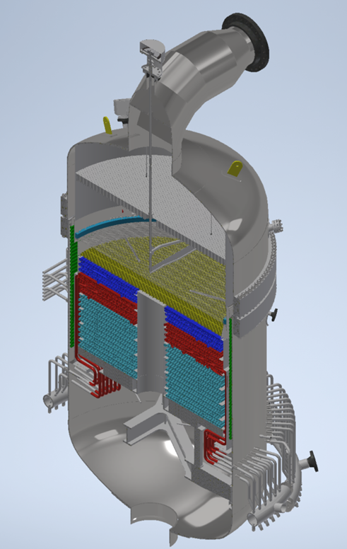
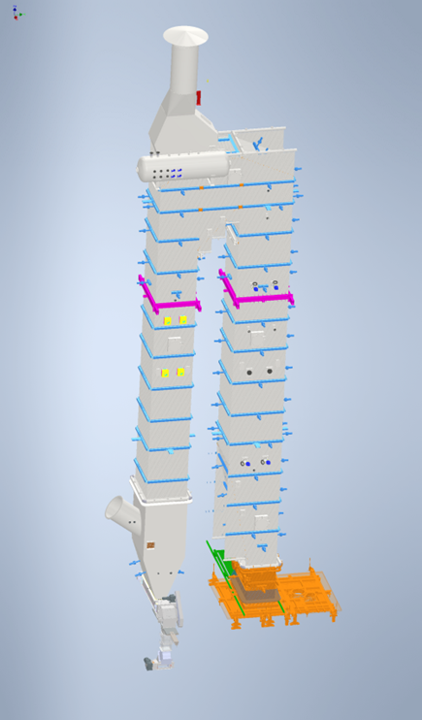
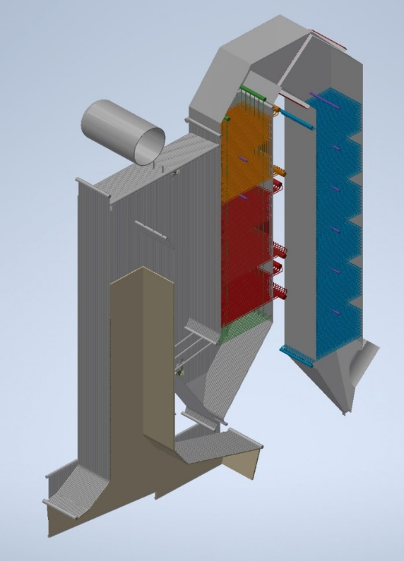
Albrecht Indutherm
Company
Services
Products
References
Contact
Products
Reactors/ Boilers for nitric acid plants
- for all licensers
Non ferrous waste heat boilers
- for IsaSmelt-, Flashsmelt-, Ausmelt- process and other processes
Boilers downstream grate systems
- Vertical an horizontal design-
Thermal Oxidizer /
Incinerators for liquid and gaseous fuels

Slide 4
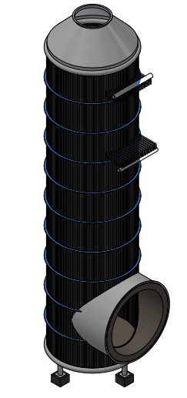
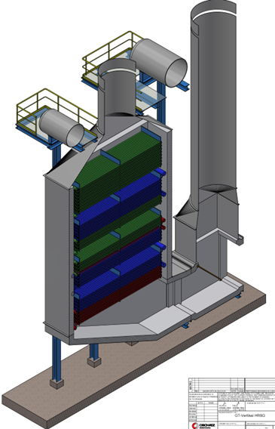
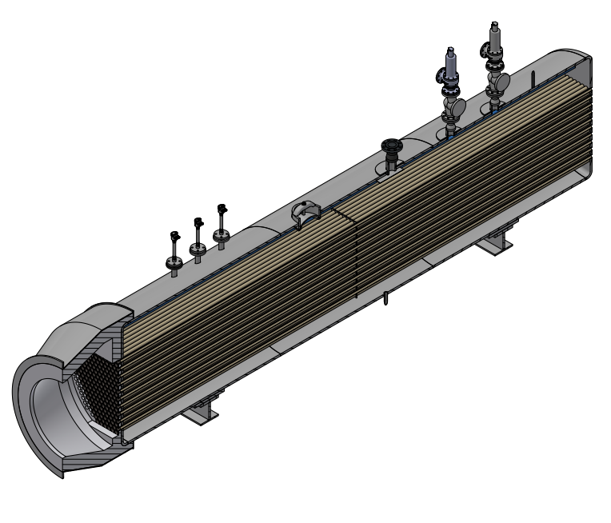
Albrecht Indutherm
Company
Services
Products
References
Contact
Products
Boilers for sulfuric acid plants
- Water tube and smoke tube type
Smoke tube boiler downstream an incinerator
Boilers downstream gas turbines HRSG
Typical Boiler types and application:
Water tube boilers for natural- and forced circulations
capacity: 5 - 200 t/h
Steam temp. : < 500
Steam pressure: < 120 bar
Design Codes: PED, ASME, GB. IVR and others
Smoke tube boilers

Slide 5
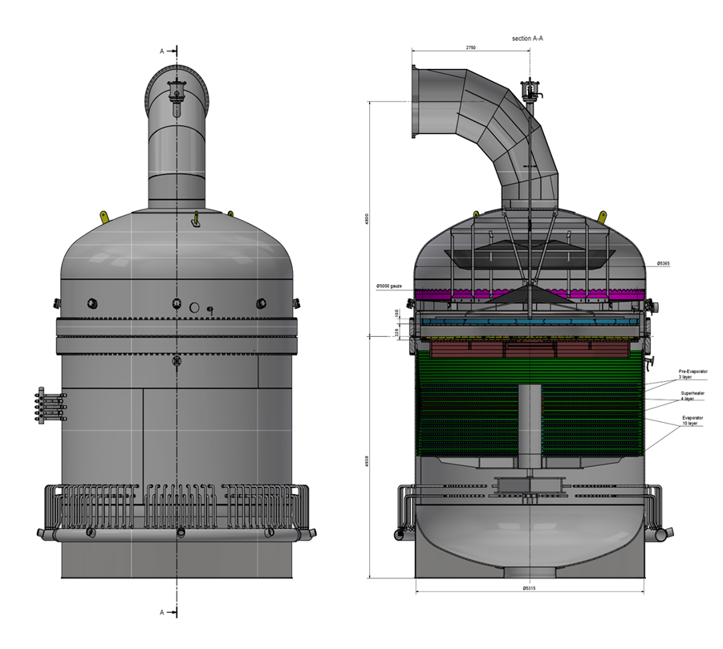
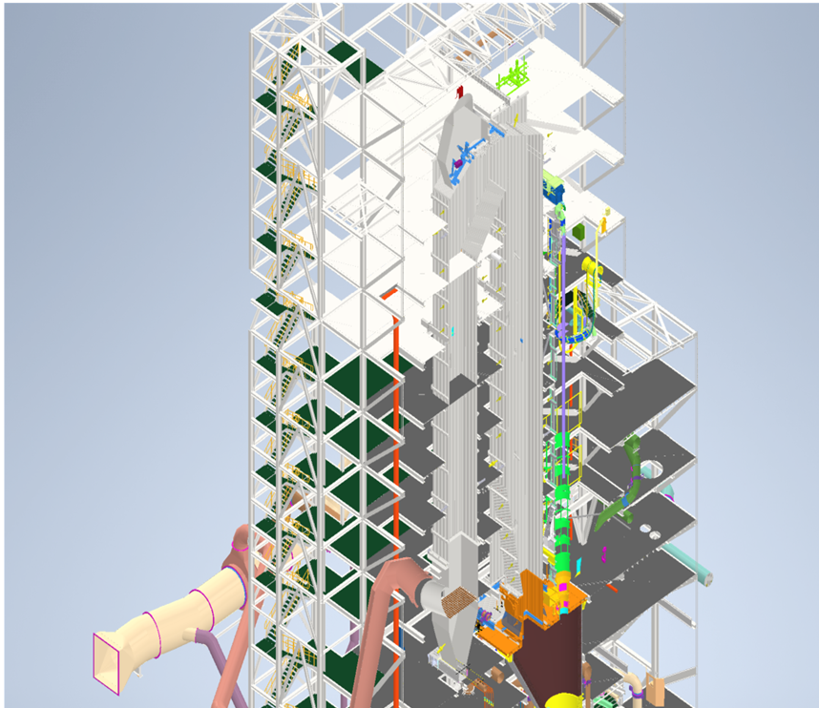
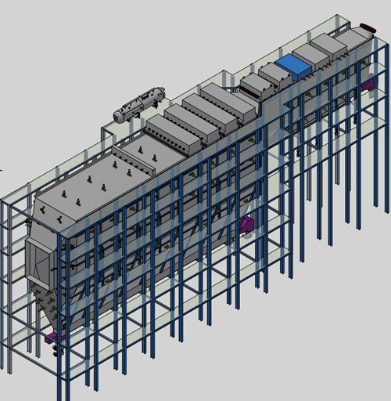
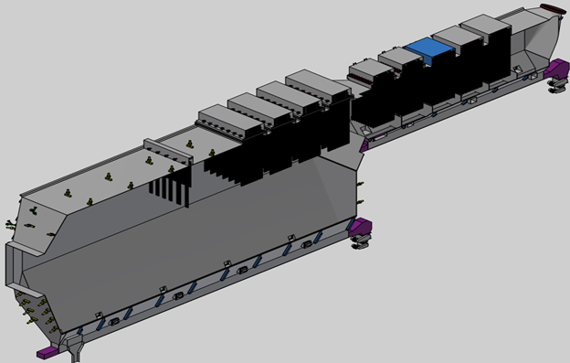
Albrecht Indutherm
About us
Services
Products
References
Contact
References (from 2022-2024)
Boiler Design for more than 20 boiler plants for the international market
Product-line of the references
Ammonia Oxidation reactors/boilers
Non- ferrous boilers
Boiler behind a grate system
Smoke tube boiler for a chemical plant
HRSG – boilers downstream agas turbine
Several feasibility studies for revamping
Boiler design experience of Albrecht Indutherm Engineers - Boiler design experience for more than 20 years
- Design on appr. 40 boiler systems for
Water tube boilers ; natural and forced circulation
Ammonia oxidation reactors/ boilers
Sulfuric acid boilers
Boiler for non ferrous industry
Direct fired boilers; water tube type
Boilers downstream incinerators

Slide 6
Albrecht Indutherm
About us
Services
Products
References
Contact
Contact
Albrecht Indutherm GmbH
Robert Schuman-Str..6
44263 Dortmund
Germany
Contact: Andreas Albrecht
E mail: info@albrecht-indutherm.com
Copyright: 2021-2024 Albrecht Indutherm GmbH / All rights reserved
Albrecht Indutherm GmbH
Registered Office: Dortmund District Court: Amtsgericht Dortmund, HRB 36085, UID: DE342180980 Managing Director: Dipl.-Ing. Andreas Albrecht

